Slide 1
INSURANCE VERIFICATION

Slide 2
Transition from Ebix to Evident – Temporary Process Update
We are in the process of transitioning from Ebix to Evident for our certificate of insurance (COI) verification and vendor compliance management. This transition will take a few weeks to be fully implemented.
In the meantime, while we finalize the move to Evident, we are using a Google Document to manually track and verify insurance information. Please review the document and confirm that your vendor has current insurance on file.
We appreciate your cooperation and patience during this transition. If you have any questions or need assistance, feel free to email covinsurance@venturacounty.gov.

Slide 3
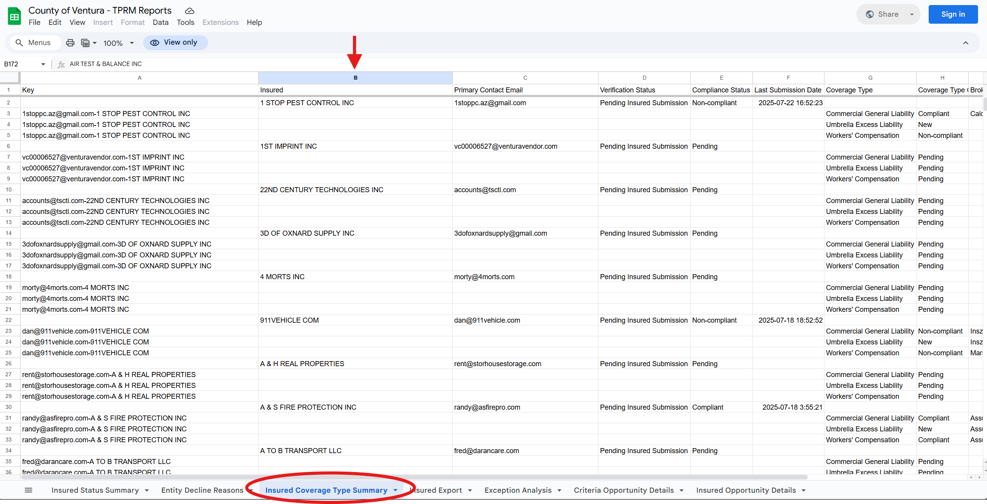
Selecting visual aids
Enhancing your presentation

Slide 4
